Slide 1


Slide 2

FOSS at UCY
Notes:
Center for renewable energy in collaboration with the centre for entrepreneurship at Cyprus

Slide 3
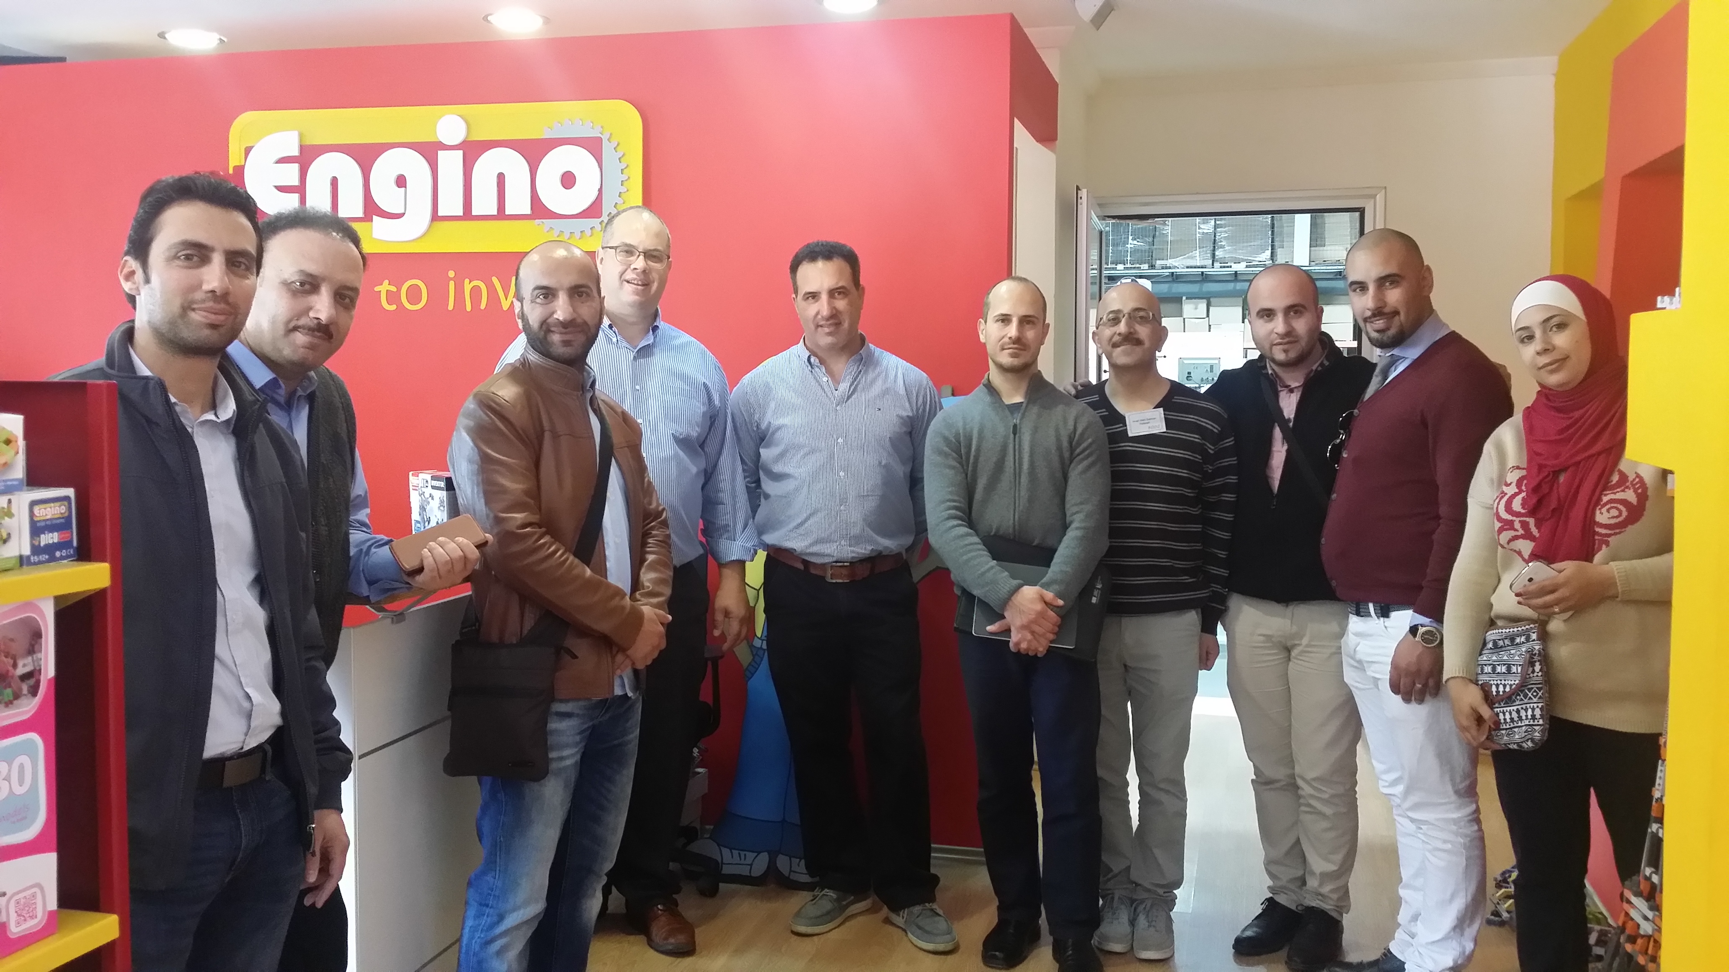
Training at UCY (March 2017)

Slide 4

Startup Experience in Boston
What I learned and what can be transferred to Jordan
Charalambos Anastassiou, Phd

Slide 5
Why Entrepreneurship
Personal Growth ambition
University advantage
New real job creation for the country
Notes:
It used to be that Universities about 200 years ago had monopoly on knowledge. They were the best places to create knowledge (through research), they were the best places to transfer that knowledge (through teaching) and for service (to apply that knowledge, develop applications, to offer consulting services. Etc.) Is that the case today? Most companies conduct excellent research. Online courses offer excellent teaching and specialized companies offer applications and consulting.
Only true way to create real jobs

Slide 6
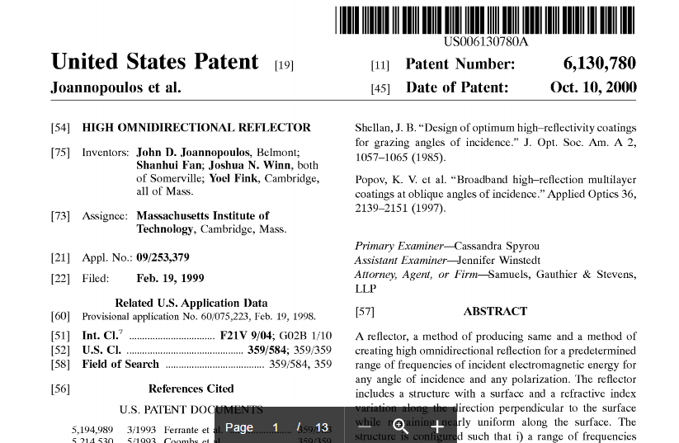
Beginning with Patent, MIT 1998

Slide 7
Patents don’t tell you
Money to start: Where to get it from whom and how much
What market to enter
What to product make? Fiber, mirror, laser
What team to built to make this

Slide 8
How are patents used?
Experience on patents
Patents are most useful for:
1. Funding. They reduce the risk for investors
2. Give you credibility.
However because so much is missing third parties are not interested in just the patents.
Best choice is therefore for the inventors to be involved in commercializing their patents

Slide 9
What to do after the discovery:
STEP 1 (actually two of them):
TEAM
&
TYPE OF PRODUCT AND MARKET

Slide 10
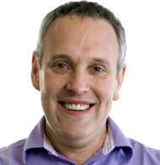
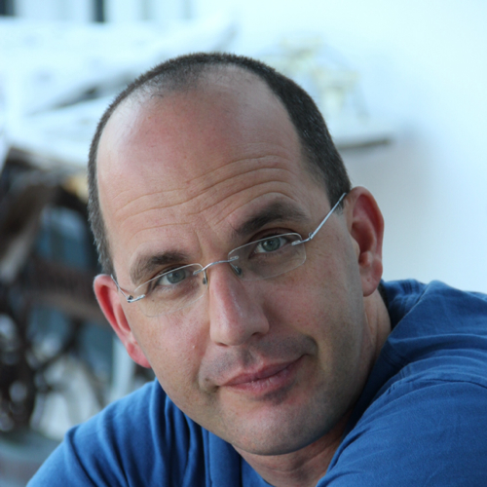
STEP 1. STARTING TEAM
TECHNICAL
BUSINESS
Yoel Fink Post Doc Physics Materials science
Uri Kolodny, MBA

Slide 11
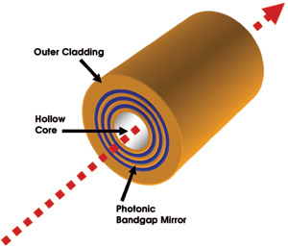
PRODUCT: FIBER
MARKET: TELECOMMUNICATIONS then PIVOT to MEDICAL
*
*

Slide 12
STEP 2. FUNDING and FOUNDING
Seed funding: MIT Competition and rich alumni (small amount)
Angel Investors 2000
  Total $4 Million
  Founding of OmniGuide Communications by 3 MIT Engineering professors and one MBA graduate

Slide 13
Technology License Office (MIT)
Once it is patented, the founders of the company work with the TLO to get exclusive rights. Inventors have preference
Patents are never assigned to the company. Just the “exclusive rights” for certain applications
“Typical” agreement was $10,000 for 2 years plus percentage revenue if used.
Notes:
Is there any fear that people will not want to patent with the
So in 2000 till 2006 we have exclusive rights to commercialize telecom applications. In 2003 we also got rights for medical applications and we keep those till today.

Slide 14
STEP 3: Don’t run out of money
Cash
GOOD
BAD
Lifetime
Notes:
At the beginning

Slide 15
Possible sources of funding
Competitions, Awards.
Rich Alumni
Angel Investor Network.
Venture Capitalists
Traditional Banks (once you have assets)
Specialized Funds (typically pre IPO. Something between traditional Bank and VC)

Slide 16
STEP 4. TEST THE MARKET
Spread and explore out at the beginning.
When the market speaks you listen. Most startups need to PIVOT.
Seek early success. A small victory boosts morale, validates your assumption and gives you momentum. It helps you move towards your target one step at a time.
Notes:
Early success makes everyone happy. Entrepreneurs, and investors. Everyone feels they are on the right track. You do not want to have 10 year development without a test in the market.

Slide 17
STEP 5. Get ready to sell
REQUIREMENT | USA | EUROPE & PARTS OF THE WORL
QUALITY SYSTEM | “21 CFR PART 820” QUALITY SYSTEM REGULATION | ISO 13485 CERTIFICATE
SPECIFIC APPROVAL FOR YOUR DEVICE BASED ON INDICATION | FDA CLEARANCE (SUCH AS 510K PREAPPROVAL) | CE MARK

Slide 18
Summary
Patent but then take next steps (either you or license)
Step 1: Set team, decide on market product
Step 2: Get initial funding
Step 3: R&D and keep getting funded.
Step 4: Test the market (prototype) early and often
Step 5: Qualify to sell
Notes:
Entrepreneurship should be promoted by both Universities and the countries.

Slide 19
Thank you very much

